Slide 1
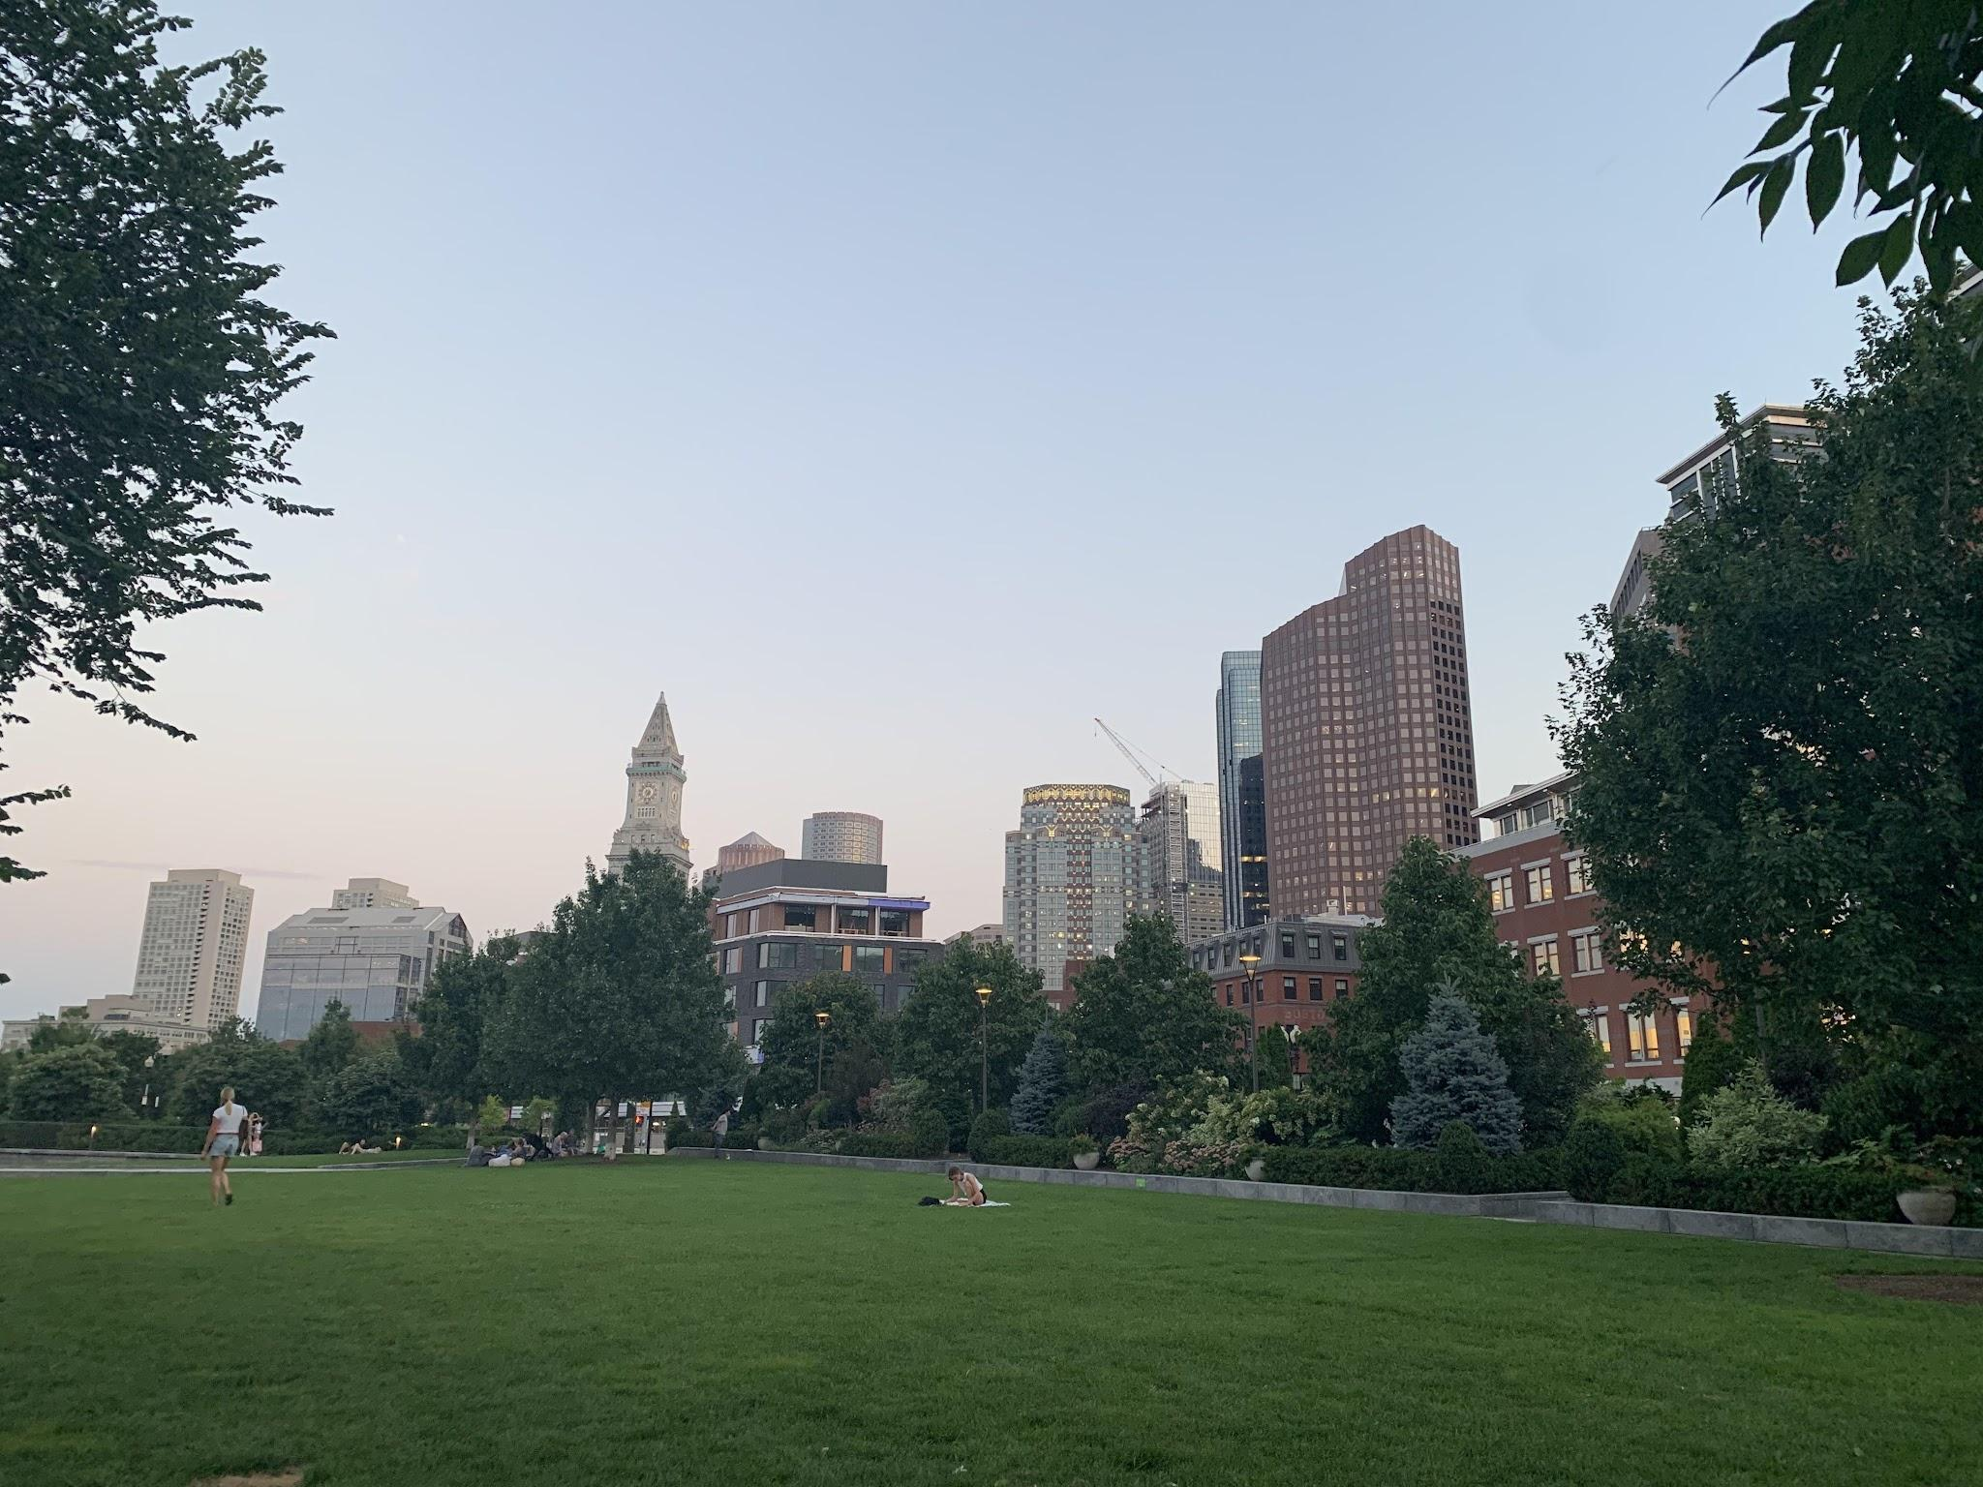

Meet4Sho
By: Erikson Monterroza,Gordon Ng,Ivan Mata,Marve Mao,Terry Li

Slide 2
Meet4Sho
A ANDROID STUDIO PRESENTATION
Presents . . .
Meetups with people you do not know, at shows you do know.

Slide 3
Walkthrough
Notes:
Demo

Slide 4
APIs
MovieGlu - an api that collects data from many different sources including film studios, press releases, distributors, and movie theaters
TicketMaster - is the world’s largest ticket marketplace for all sports events, concerts, plays, etc.
Yelp - contains a collection of data about restaurants, i.e. overall rating, type of food, hours, address, etc.
Most businesses already know that social media platforms play an important role in online marketing. Content is the beating heart of social media marketing and is what drives engagement, traffic and conversions. When it comes to content, there are a few golden rules that help you connect with your audience.
There are people who have a significant number of followers in every business domain on social media. These influencers create detailed content that provides useful information. They are typically fair in their analysis of different brands and products and very often, their audiences trust their content. Your brand can leverage this by collaborating with influencers.

Slide 5
MovieGlu
Request Headers: client, x-api-key, authorization, territory, api-version, geolocation, device-datetime
Example API Endpoint:
https://api-gate2.movieglu.com/filmShowTimes/?film_id=12345&date=2018-04-12&n=10
Objects Returned: Film object containing film_id, film name, etc.

Slide 6
Ticketmaster
Request Headers: API key
Example API Endpoint:
https://app.ticketmaster.com/discovery/v2/events.json?apikey=(API-Key)&city=Boston&keyword=Pop
Objects Returned: Event unique ID’s, event date, venue address, etc.

Slide 7
Yelp
Request Headers: API key, Bearer Authorization
Example API Endpoint:
https://api.yelp.com/v3/businesses/search?latitude=42.350498&longitude=-71.105400&categories=japanese&price=2&sortby=distance
Objects Returned: restaurant_id, review count, ratings, price etc.

Slide 8

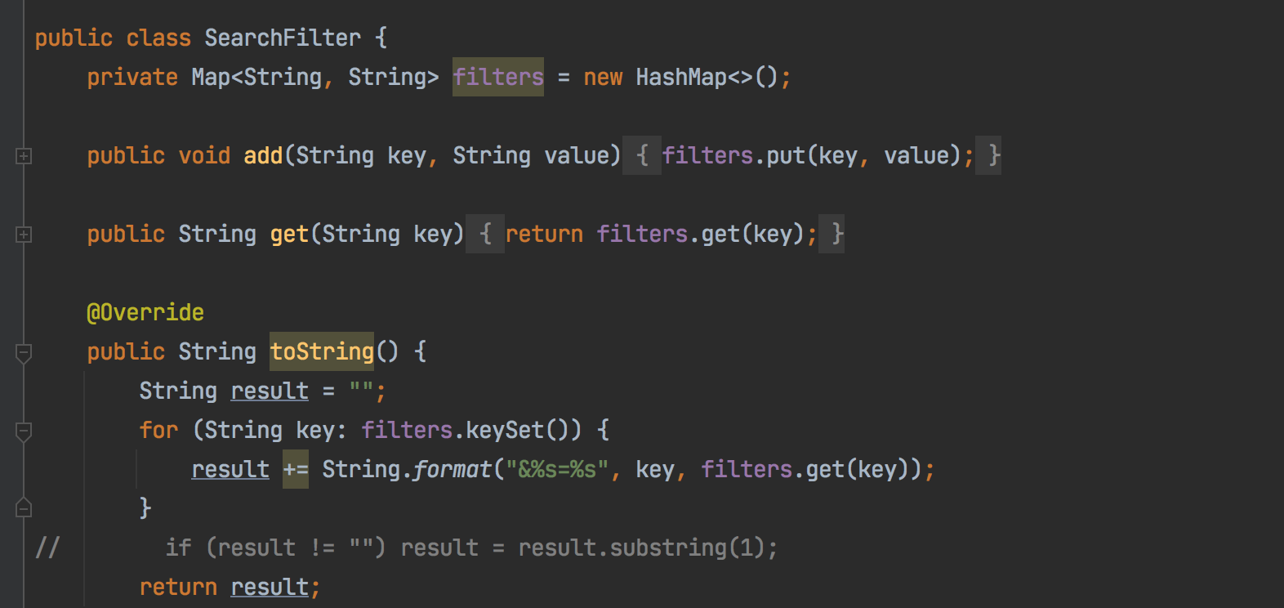
YOUR TITLE
API Request
How to start a request:
- register a listener
- register a search filter
- register api request
SearchFilter:
- a map of filters
- filter example: - <name, The Batman>
Notes:
API Screenshots of Code and Screen

Slide 9
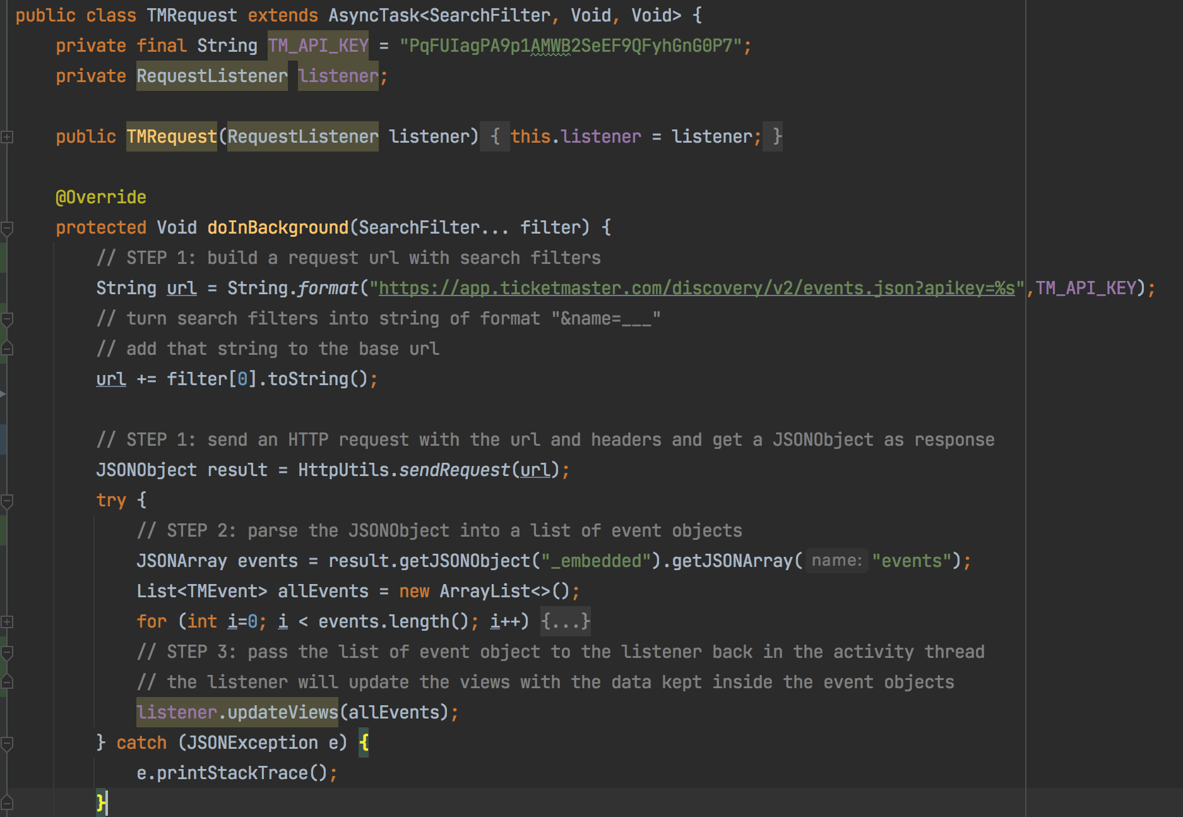
YOUR TITLE
API Request
STEP 1: - build the request url
STEP 2:
- send a GET request
- return a JSON object
STEP 3:
- parse the JSON object
- into a list of event objects
STEP 4:
- pass the event objects to listener
- listener will update the views
- with data from event objects
Notes:
API Screenshots of Code and Screen

Slide 10
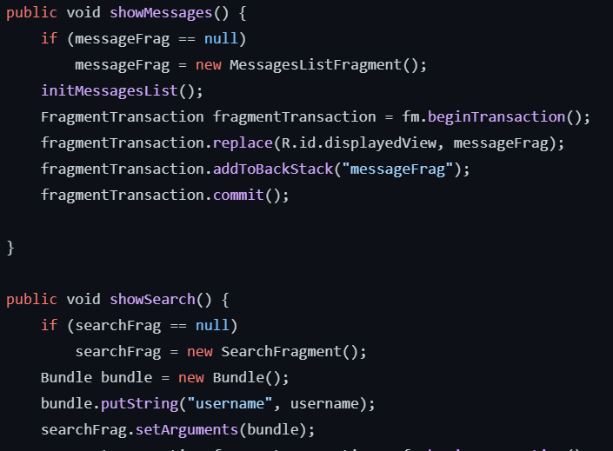
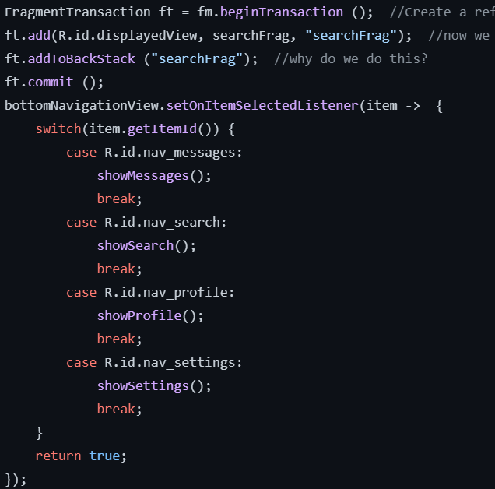
Fragment Manager

Slide 11
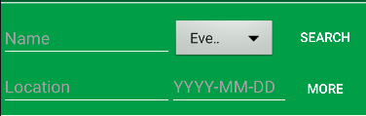
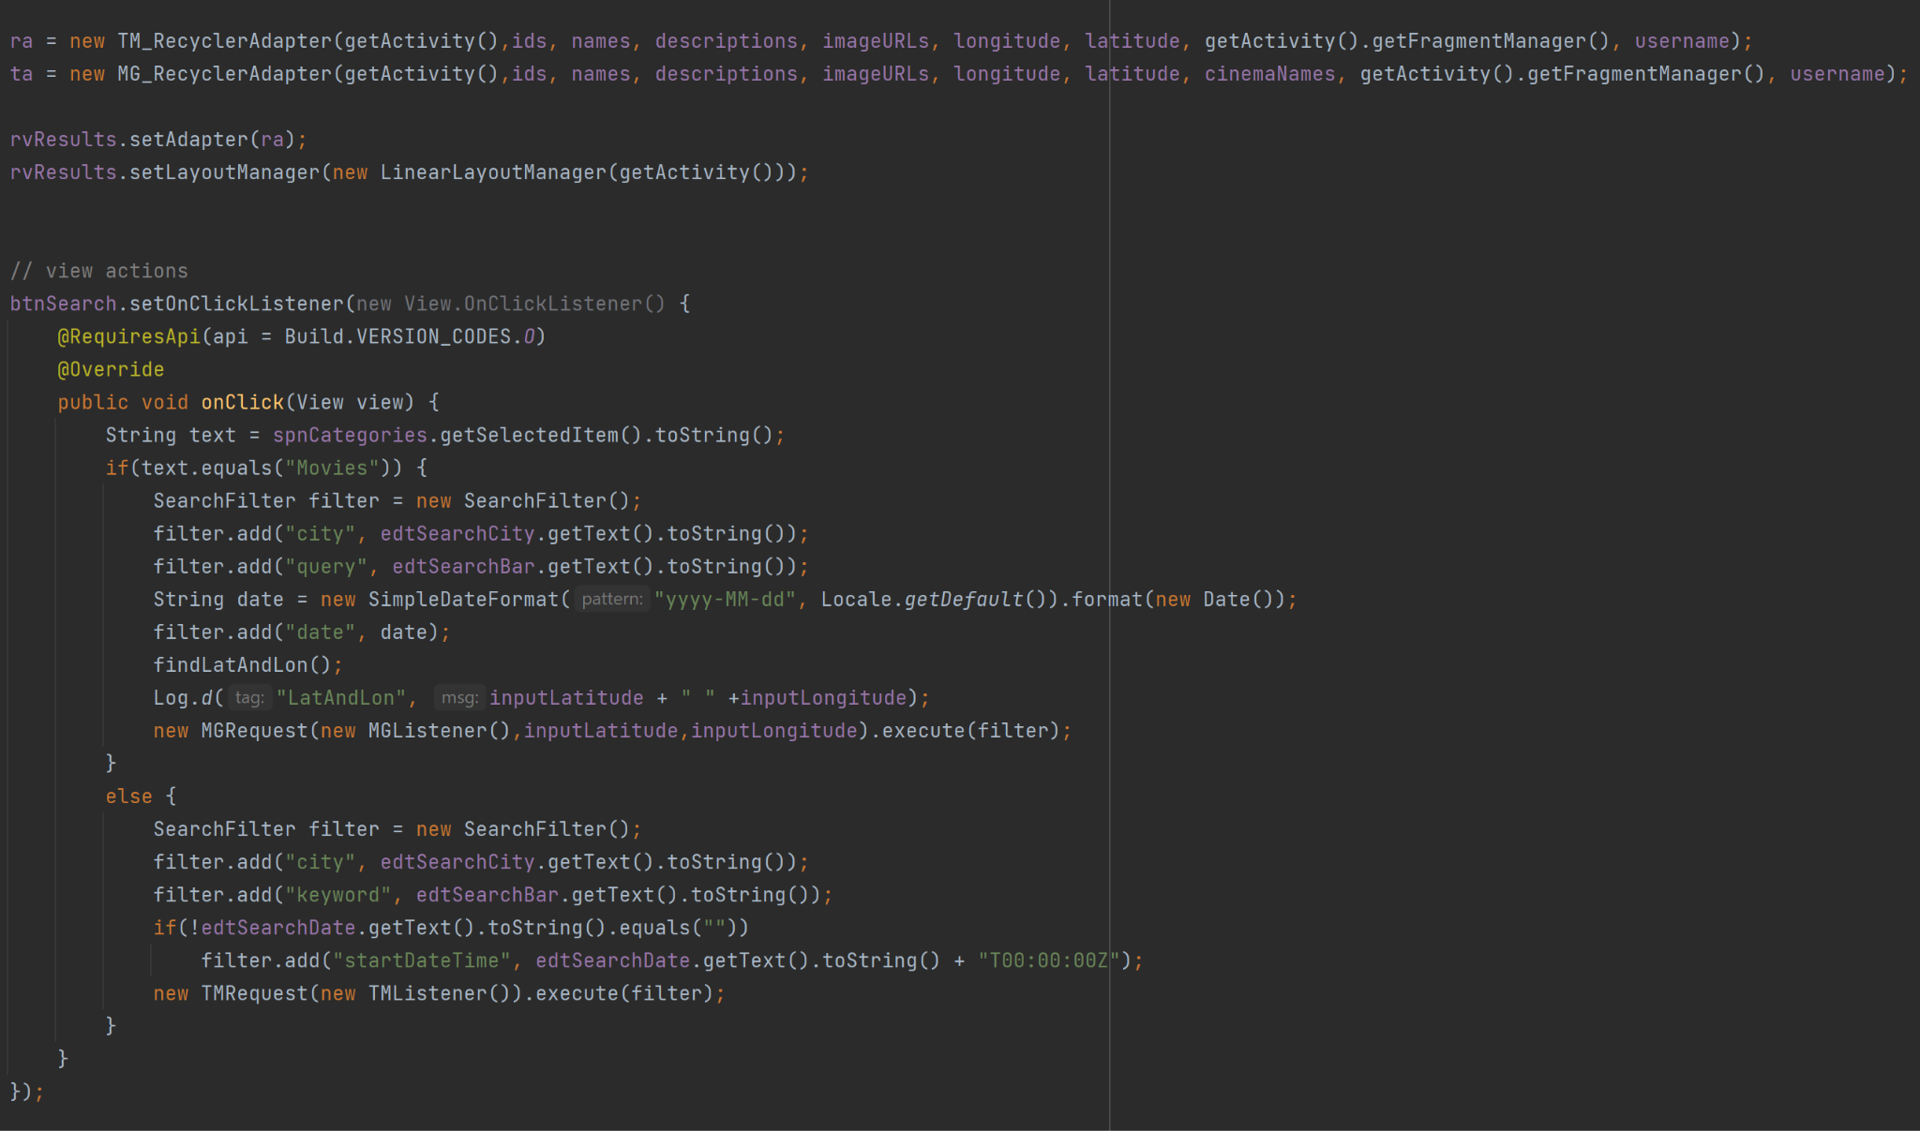
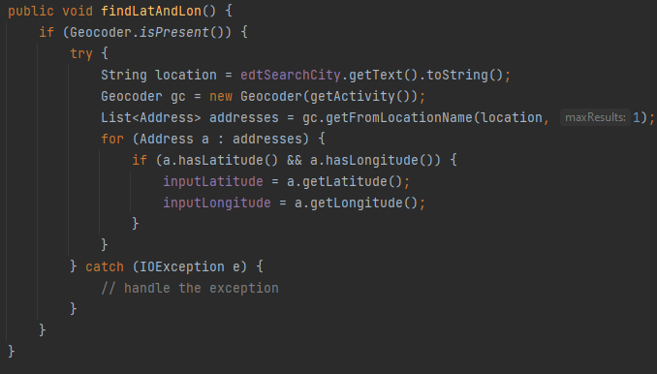
SearchFragment
Notes:
API Screenshots of Code and Screen

Slide 12
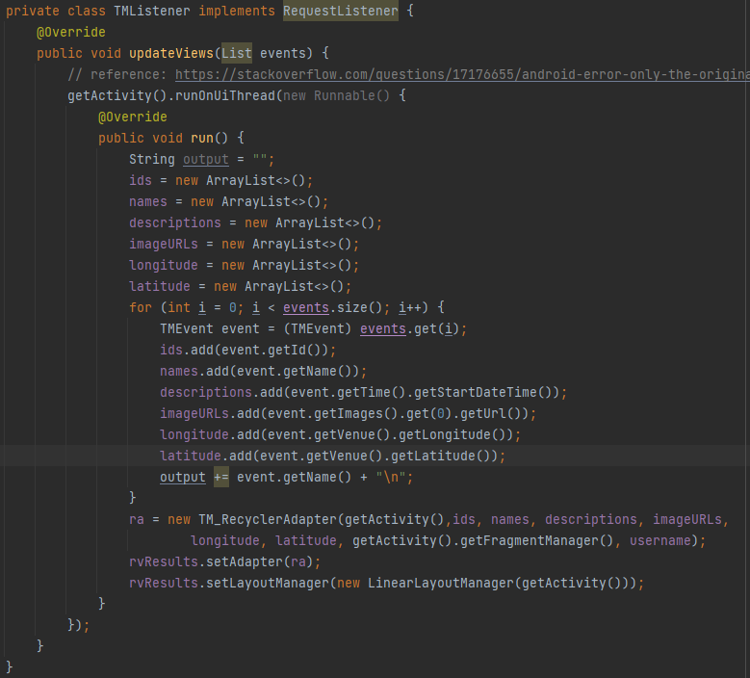
SearchFragment
Notes:
API Screenshots of Code and Screen

Slide 13
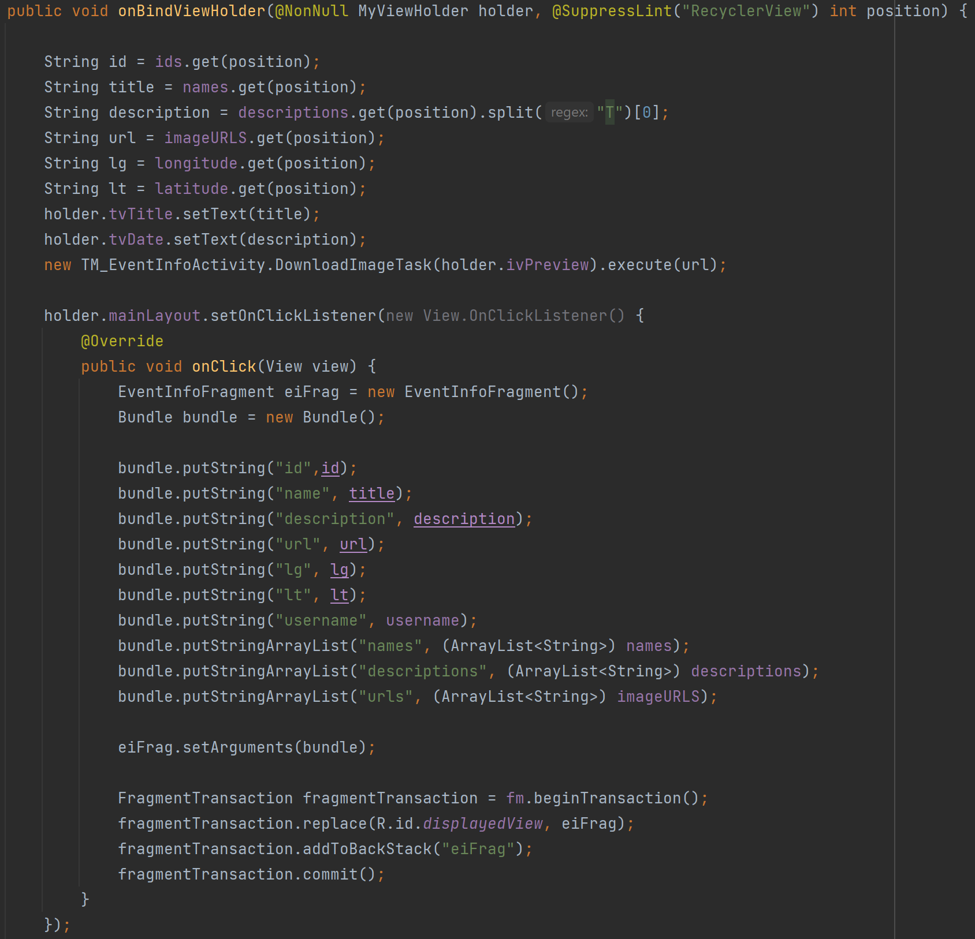
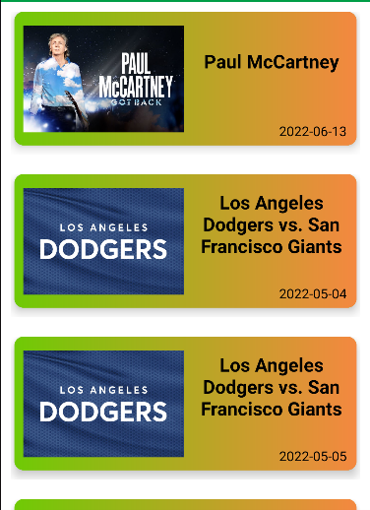
RecyclerView
Notes:
API Screenshots of Code and Screen

Slide 14
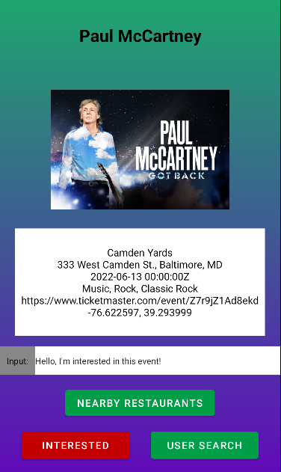
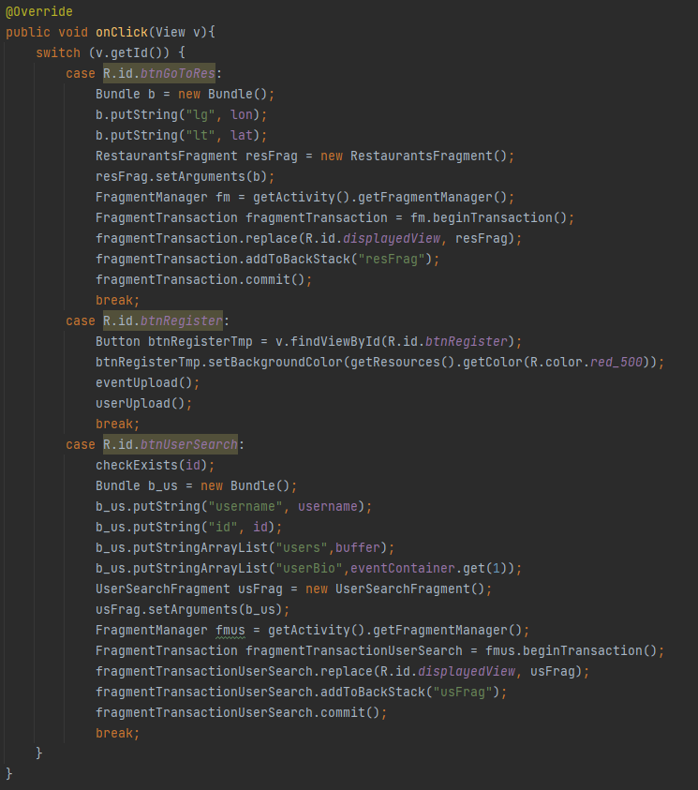
EventInfoFragment
Notes:
API Screenshots of Code and Screen

Slide 15
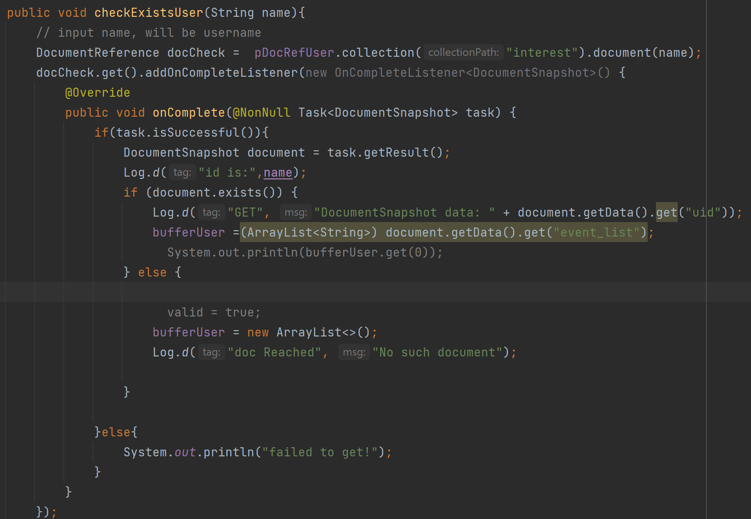
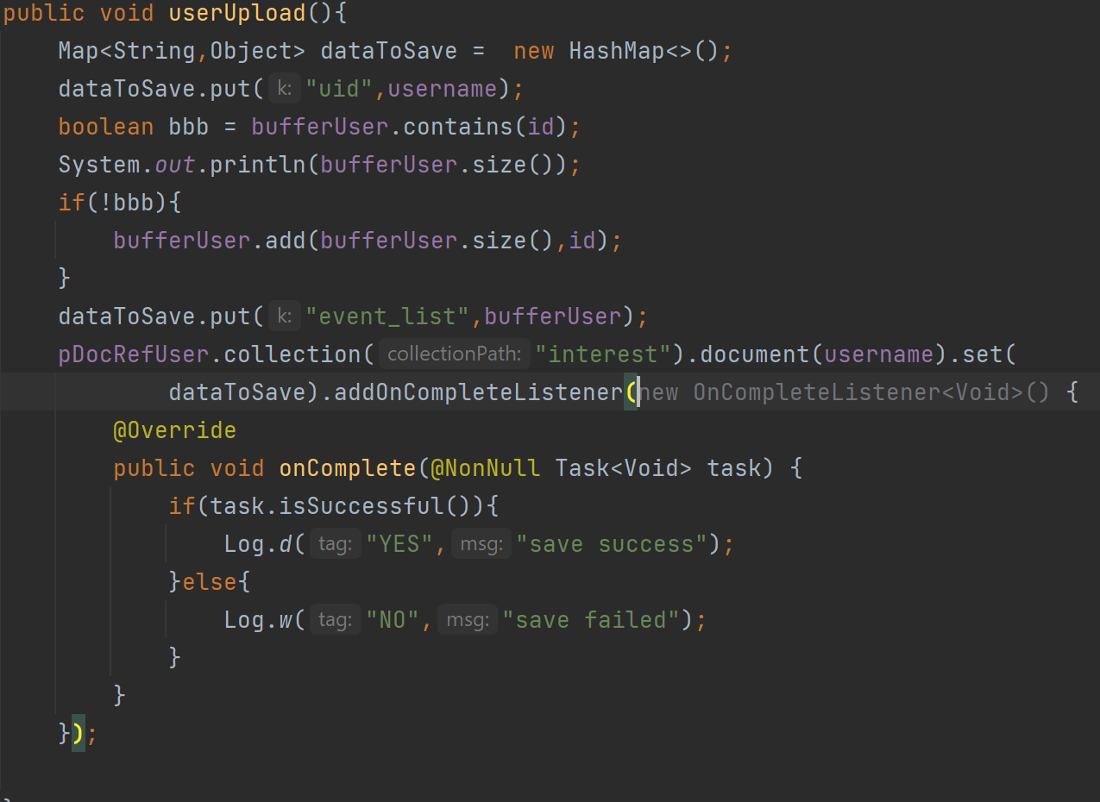
EventInfoFragment
Notes:
API Screenshots of Code and Screen

Slide 16
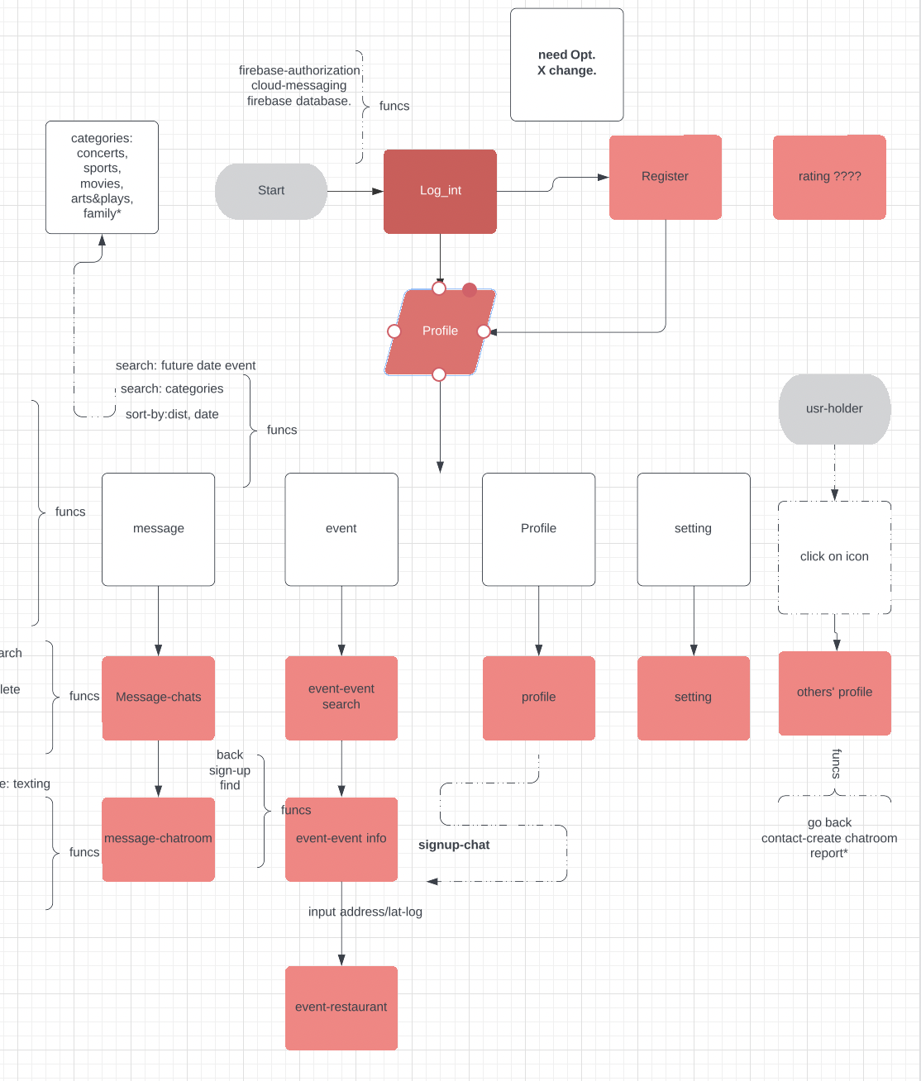

Slide 17
Users DON’T want to be SOLO!
How to connect users to events?
How to save users’ precious event memory?
How to share happiness between users?
Notes:
Meetups with people you do not know, at shows you do know.

Slide 18
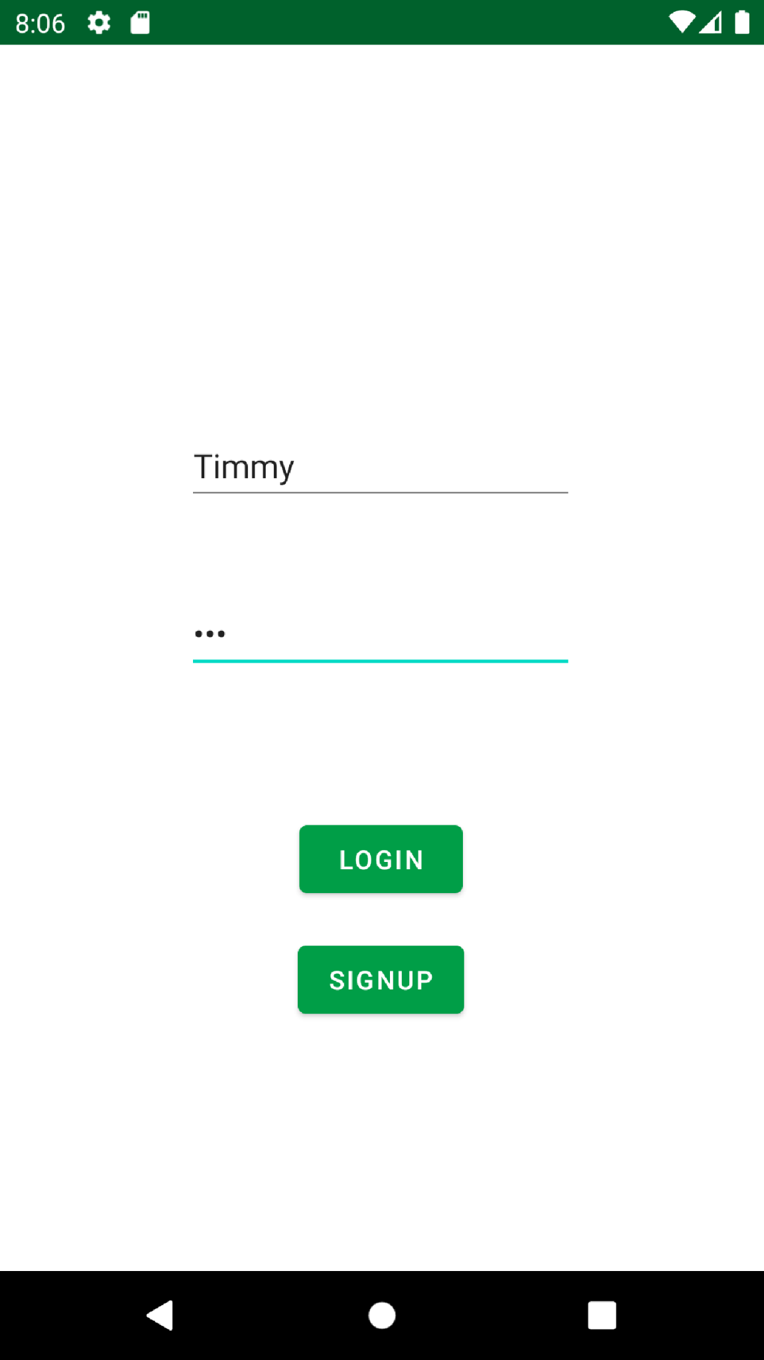
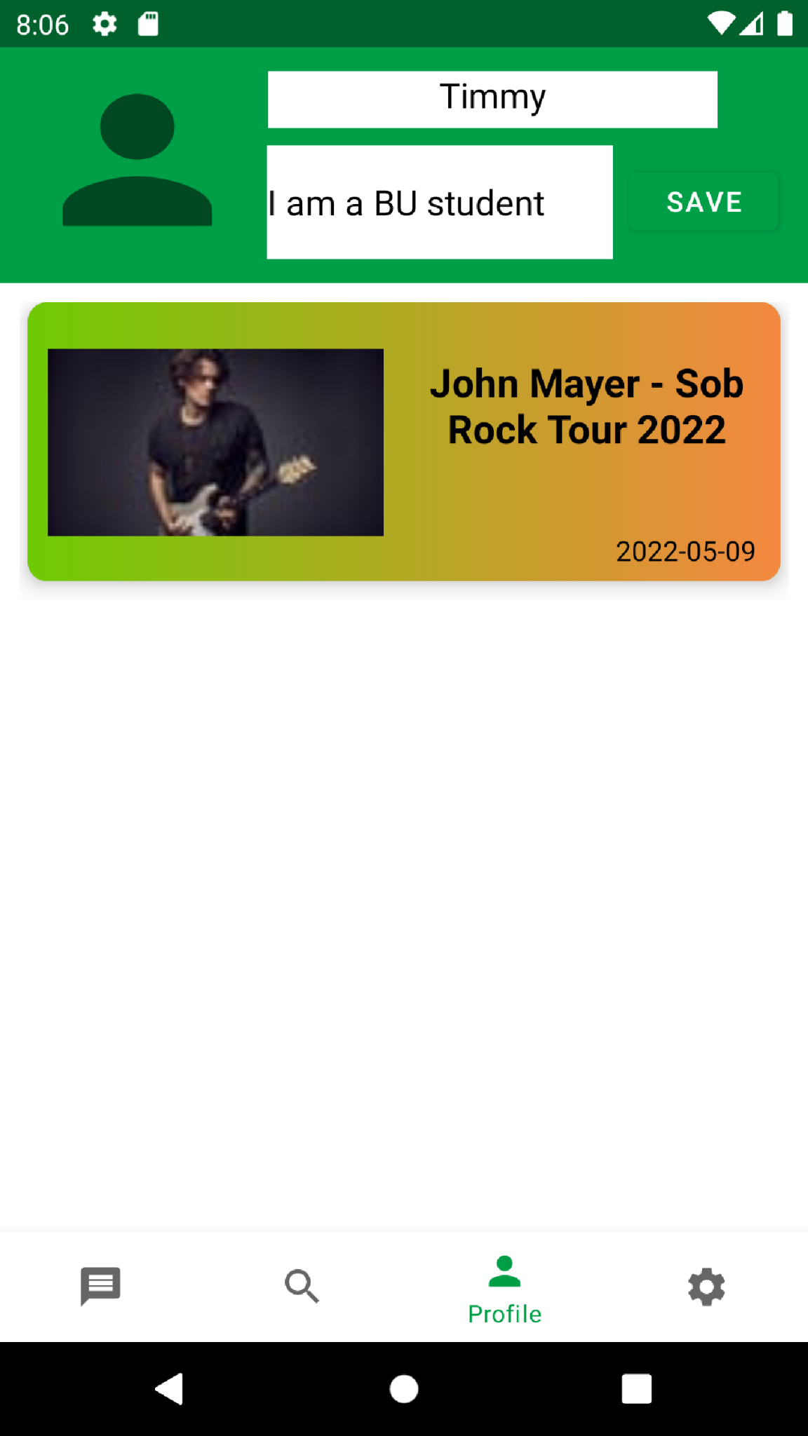
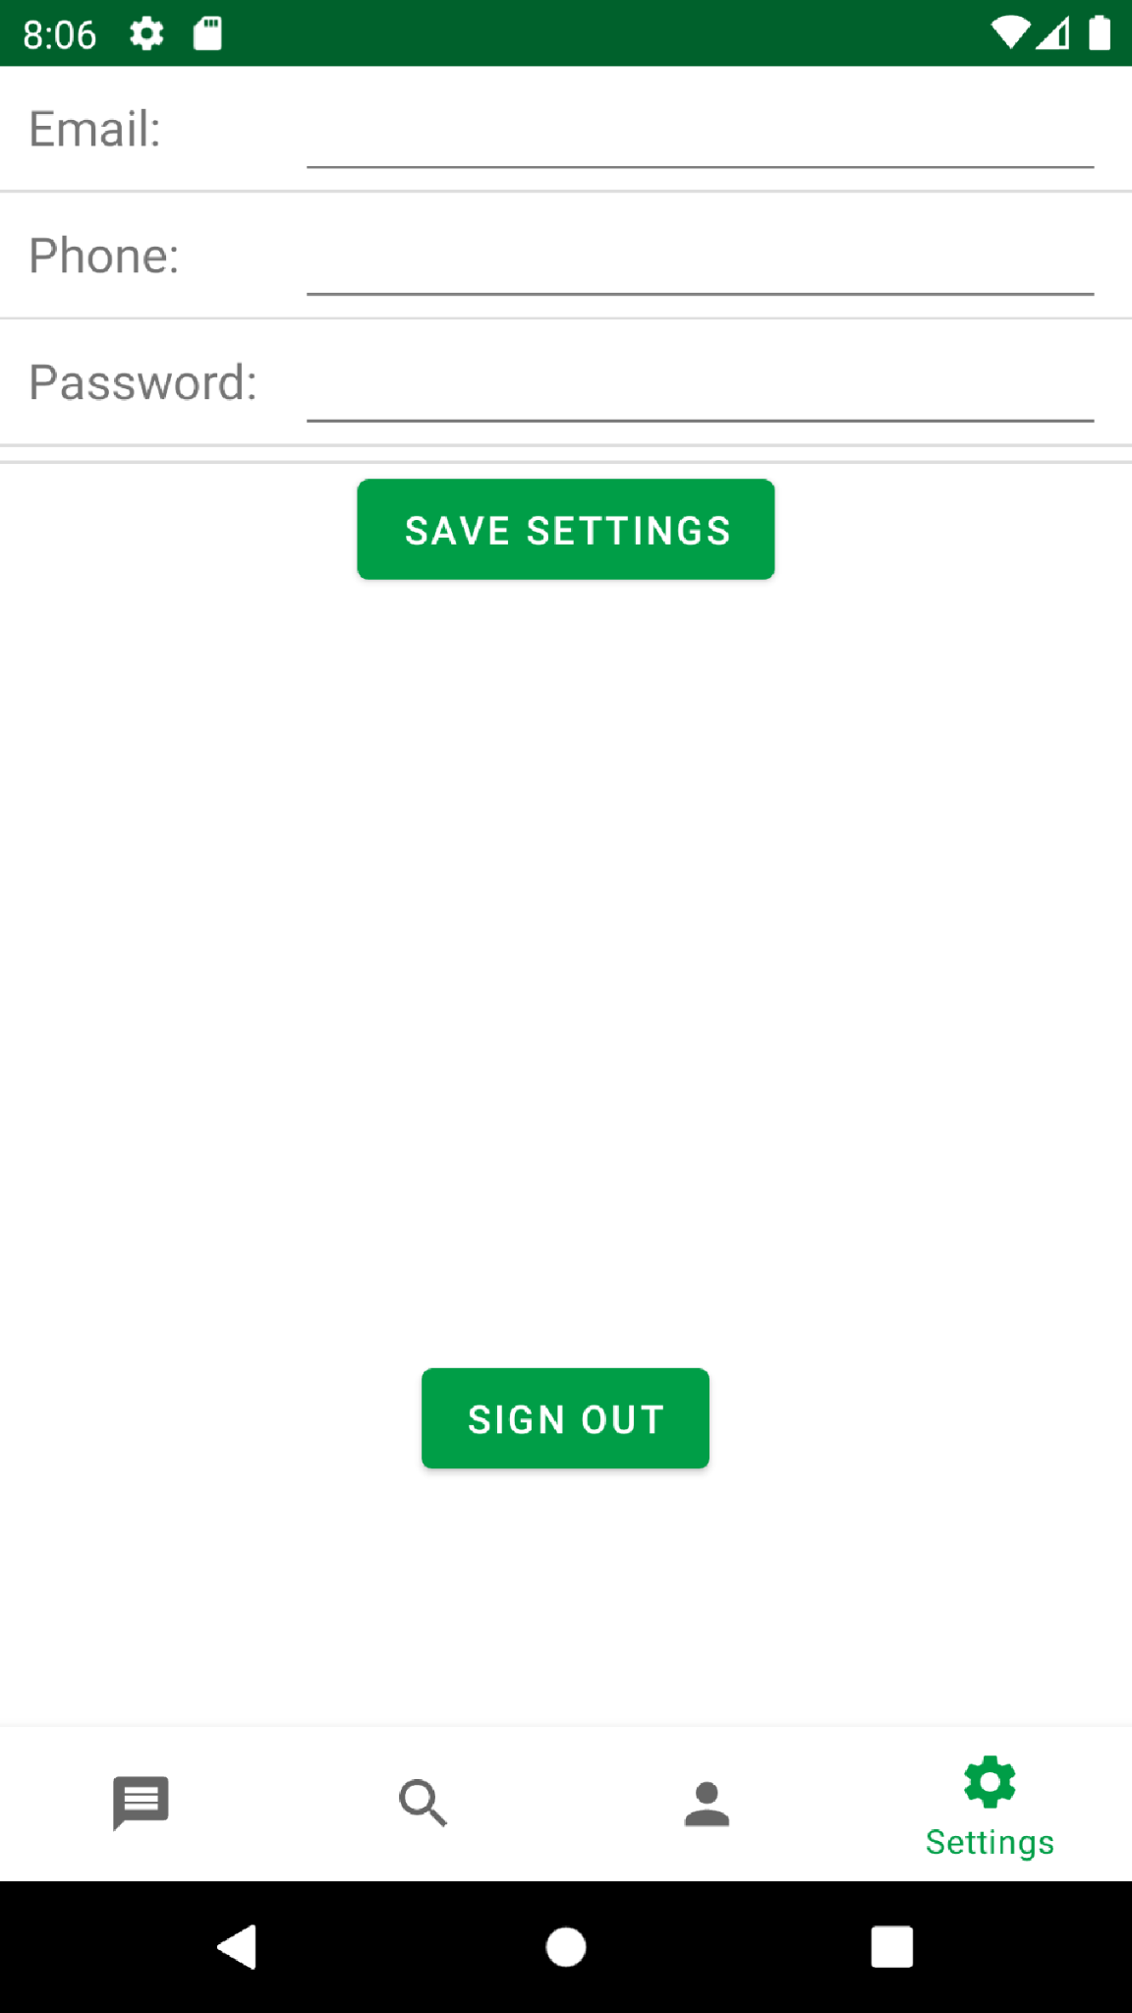

Slide 19
Database

Slide 20
YOUR TITLE
Firebase
Easy to integrate
Safe with rules
Better for further extensions
Notes:
GUI Information Main Search Page

Slide 21
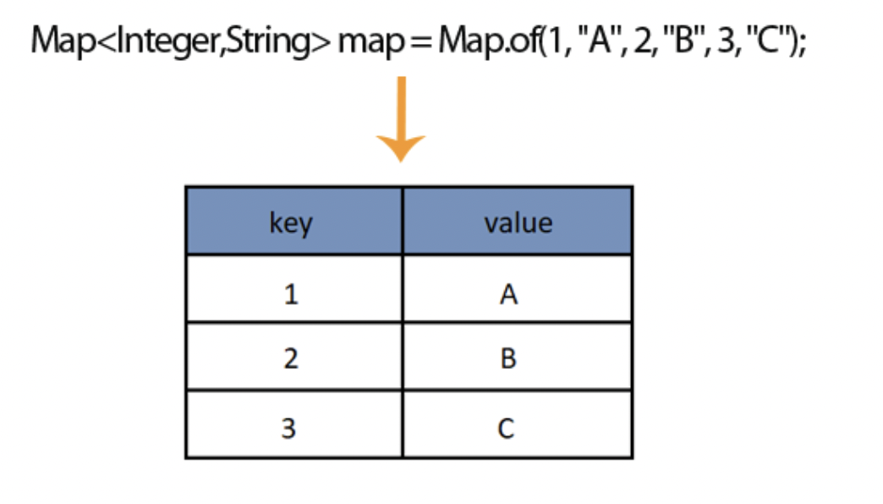
Fetch DATA
Upload DATA

Slide 22
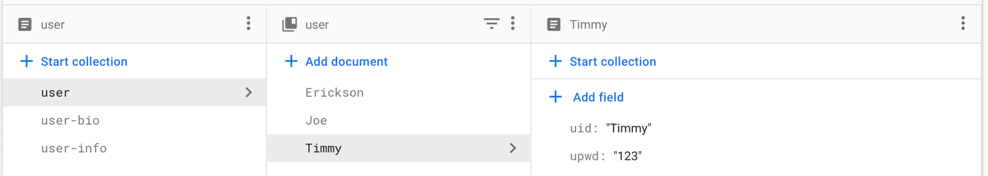
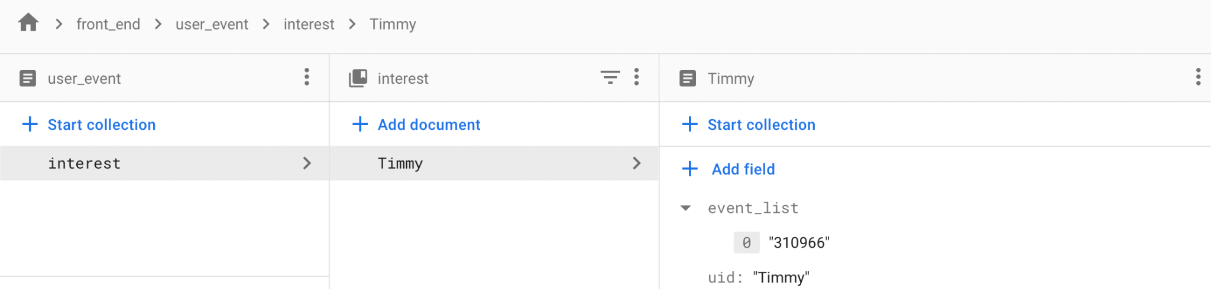
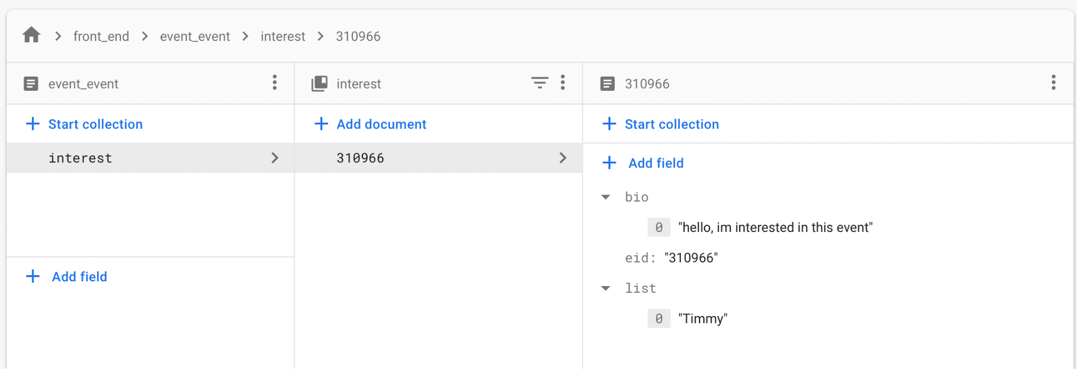

Slide 23
CometChat
CometChat is communication platform that provides easy to use text chat
A user has an ID linked to their Meet4Sho account
This ID is used to fetch their conversations in CometChat as well

Slide 24
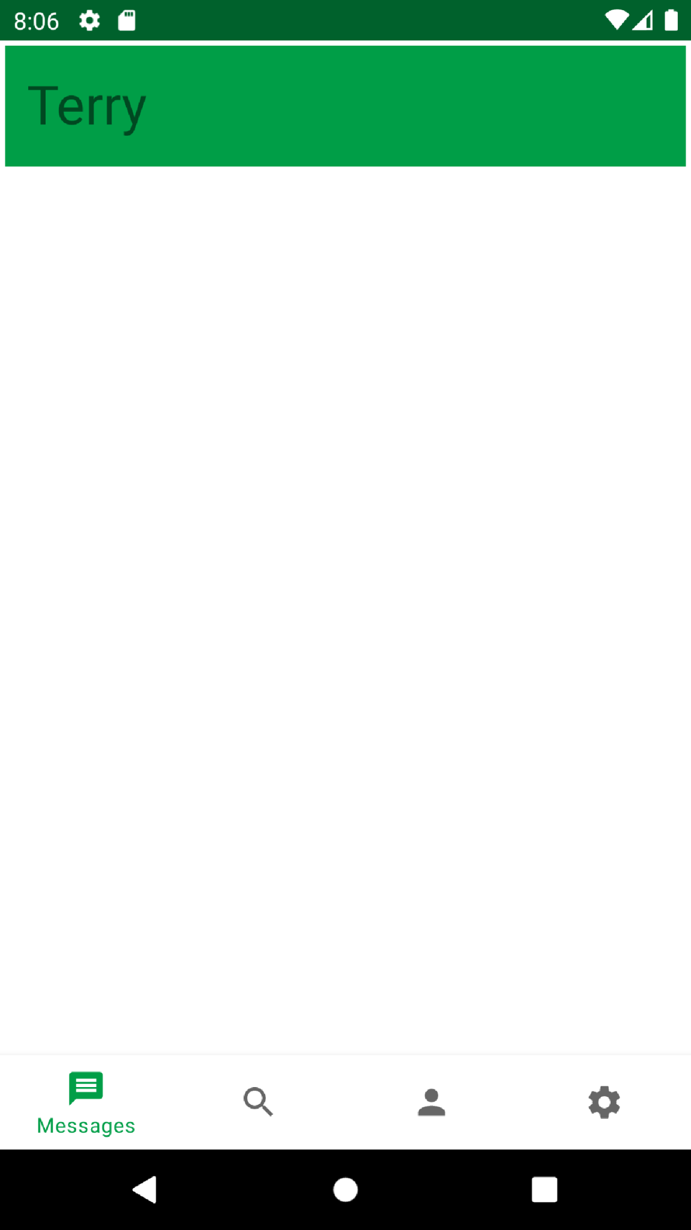
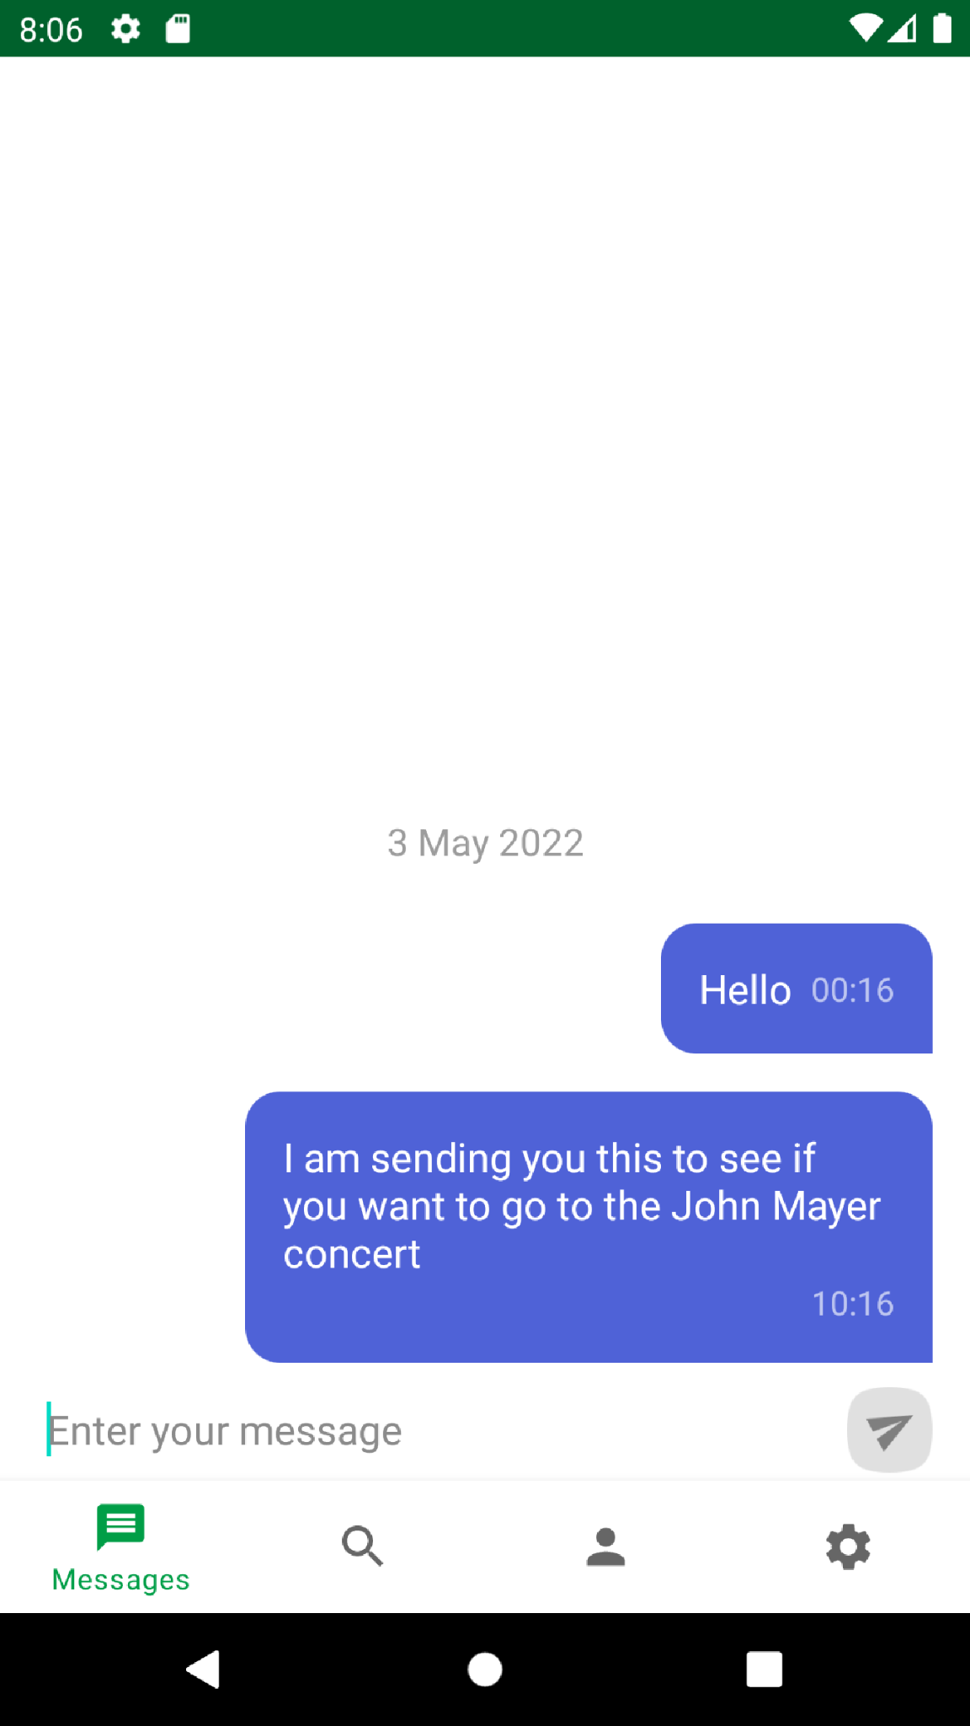

Slide 25
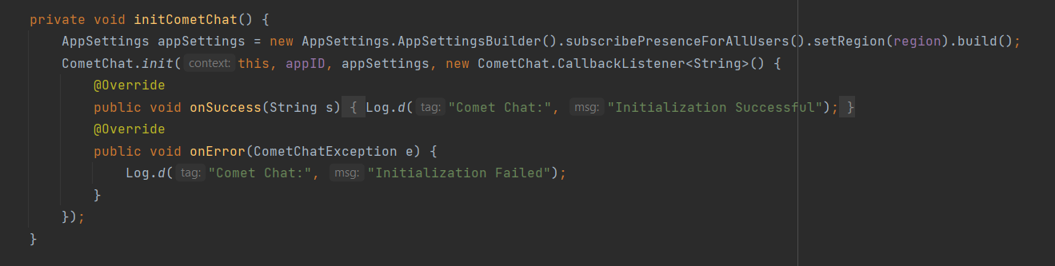
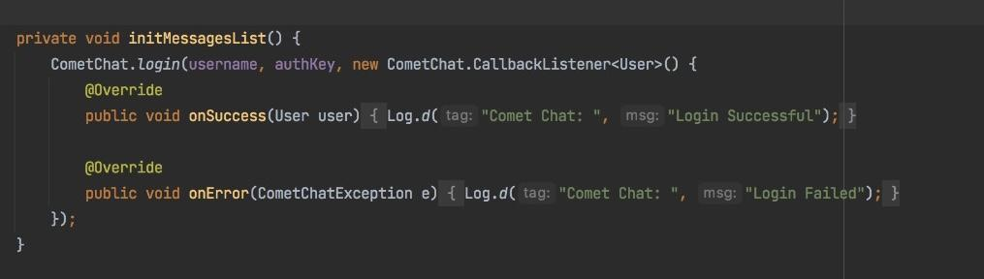

Slide 26
Setbacks/Roadblocks
Fandango API - Discontinued
AMC API - Discontinued
The Movie Database API - Doesn’t provide local movie theatre info or showtimes

Slide 27
Future Implementations
-Add a voice manager, where it reads out your texts
-Add multi-person support for the chat
-Allow phone calls and video calls through CometChat
-Buying tickets for the events
-Google authorization
-Security
-Allow for cinema searches outside of the US

Slide 28
Q/A

